Slide 1

BEE Take HOME TEST
Automatic Irrigation Under Smart Farming
Done By :- Aryan Dilipbhai Langhanoja (92200133030 – 1st Sem)
Submitted To :- Prof. C D Parmar Sir & Prof. Rakesh Oza Sir

Slide 2
Problem Statement :-
In a smart farming concept in support with digital India movement automatic irrigation using GSM phone will provide comfort to farmers (Many times electricity is available at only night time in a farm). A pump is facilitating with GSM receiver to control (ON/OFF) from remote place. A Text to Voltage Decoder module is available to generate 5V at output terminal in case of received SMS text is ON and 0V in case of OFF. A switch at the farm is also installed to active this automation facility. If switch is off then water pump is on manual setting for on and off. Output of switch is 2.5 V during ON condition.

Slide 3
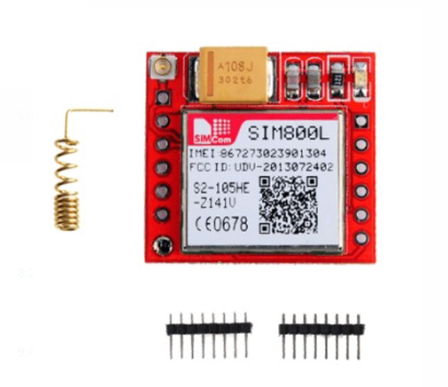
GSM MODULE – SIM800L
The SIM800L is a compact and cost-effective GSM/GPRS module that is commonly used for applications that require connectivity to a mobile network. It supports quad-band GSM/GPRS network, providing reliable wireless communication for M2M (machine to machine) applications. It is equipped with a UART interface, making it easy to integrate with microcontrollers and other devices. The SIM800L supports a wide range of functions including GPRS data transfer, SMS messaging, and voice calls. It operates on a voltage range of 3.4V to 4.5V and is suitable for low power applications.

Slide 4
SPECIFICATIONS OF SIM800L
Specifications | Values
Frequency | 850/900/1800/1900 MHz
Protocols | GSM/GPRS
Power Supply | 3.4 to 4.4 V
Power Consumption | 1.5 mA in sleep mode and 2.7 mA in transmission
Operating Temperature | -40 ºc to +85ºc
Dimenssion | 24.9 mm x 24.9 mm x 2.7 mm
Weight | 2.7 g
Antena Type | On-board ceramic antenna
Communication | Voice Calls and SMS

Slide 5
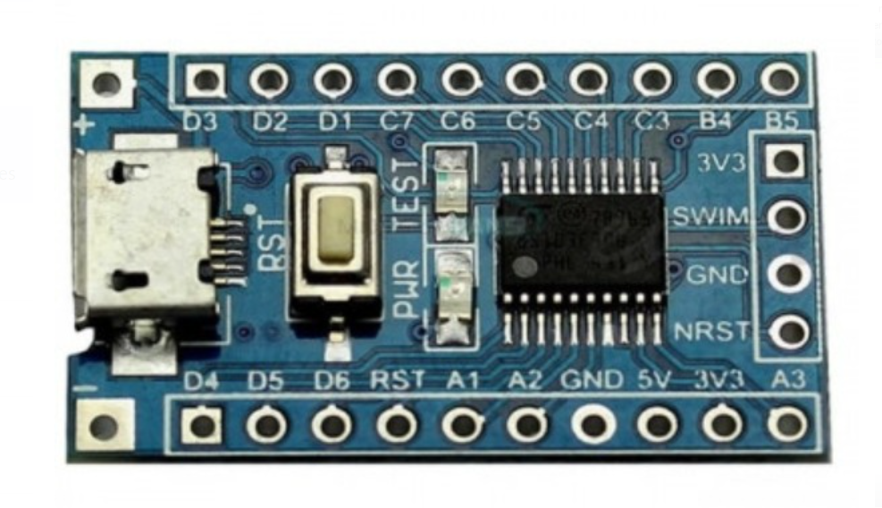
STM8S103F3P6 Core BOARD
The STM8S103F3P6 core board is a development board based on the STM8S103F3 microcontroller from STMicroelectronics. The microcontroller is based on the 8-bit STM8 architecture and features a maximum operating frequency of 20 MHz, 32 KB of flash memory, and 1 KB of RAM.
The STM8S103F3P6 core board includes a range of peripherals and interfaces, including an ADC, timers, USART, I2C, and SPI, which makes it suitable for a wide range of applications. It also has an on-board debug interface that enables real-time debugging, making it easier to develop and test applications. Additionally, the board can be programmed using a variety of tools and development environments, including the ST Visual Develop (STVD) IDE and STM8 CubeMX.

Slide 6
SPECIFICATIONS OF STM8S103F3P6 Core BOARD
Specifications | Values
Controller | STM8S 8-bit CISC CPU
Frequency | 16 MHz
Memory | 1 KB of RAM 32 KB of flash memory
Interfaces | 1 USAT , 1 I2C , 1- SPI, 1- ADC and 2 timers
GPIO Pins | 20 Digital Pins
ADC | 10 – bit ADC
Operating Voltage | 2.95 V to 5.5V
Operating Temperature | -40 ºc to +85ºc

Slide 7
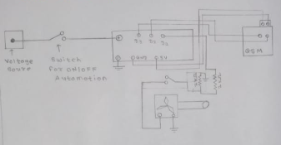
CIRCUIT DIAGRAM

Slide 8
ALGORITHM
Step – 1 :- Start
Step –2 :- Read Message
Step – 3 :- Set Message Length ← strlen(Message)
Step – 4 :- if (Message Length == 3 ) digitalWrite(1 , LOW)
else if (Message Length == 2 ) digitalWrite(1 , HIGH)
Step – 5 :-Stop

Slide 9
BLOCK DIAGRAM
GSM Module
STM8S103F3P6 Core Board
Water Pump
Switch

